Slide 1

Advanced pipelining techniques for superscalar processors
Computer Organization and Architecture | Hardwired and Microprogrammed Control
Course: Computer Organization and Architecture | Chapter: Hardwired and Microprogrammed Control | Program: Bachelor of Engineering
DISCOVER · LEARN · EMPOWER
Notes:
Welcome everyone to today's lecture on advanced pipelining within the context of control units. We are focusing specifically on how superscalar processors achieve high performance through parallel instruction execution. This session builds directly on our understanding of hardwired and microprogrammed control mechanisms. Let us begin by exploring the core outcomes of this module.

Slide 2
Course Outcomes
SLIDE 2 / 10
Course Outcome
CO | BT LEVEL | DESCRIPTION
CO1 | BT3 | Apply number systems and digital logic to design basic digital circuits
CO2 | BT4 | Analyze register organization and instruction set architecture
CO3 | BT3 | Implement computer arithmetic algorithms and floating-point operations
CO4 | BT5 | Analyze memory hierarchy and input-output organization
CO5 | BT6 | Evaluate control unit design and pipelining performance
Chandigarh University
2 / 10
Notes:
Our primary goal for this lecture is to meet Course Outcome 5. You will learn to evaluate how control unit designs impact the performance of pipelined superscalar processors. This involves analyzing trade-offs between hardware complexity and execution speed. By the end, you should be able to critique different control strategies effectively.

Slide 3
Learning Objectives
SLIDE 3 / 10
Learning Outcomes
1
Analyze the role of control units in managing multiple instruction fetches.
2
Evaluate techniques for dynamic instruction scheduling and register renaming.
3
Assess the impact of branch prediction on superscalar throughput.
4
Synthesize a control strategy for handling structural hazards in parallel execution.
5
Critique the performance limits of hardwired versus microprogrammed control in superscalars.
Chandigarh University
3 / 10
Notes:
By the end of this session, you will be able to analyze how control units manage multiple instruction fetches simultaneously. We will evaluate dynamic scheduling techniques that allow the processor to reorder instructions for better efficiency. You will also assess how branch prediction algorithms minimize pipeline stalls in complex control flows. Finally, we will synthesize a control strategy to handle structural hazards effectively.

Slide 4
Lecture
SLIDE 4 / 10
Superscalar Definition and Control Needs
1
Superscalar processors execute more than one instruction per clock cycle using multiple pipelines.
2
The control unit must decode and dispatch multiple instructions simultaneously to functional units.
3
Hardwired control is preferred for speed due to the need for rapid instruction dispatch.
4
Microprogrammed control offers flexibility but may introduce latency in high-frequency superscalar designs.
5
The control unit must resolve data dependencies before issuing instructions to avoid stalls.
Chandigarh University
4 / 10
Notes:
Superscalar processors are designed to execute more than one instruction per clock cycle by utilizing multiple parallel pipelines. This requires the control unit to decode and dispatch multiple instructions simultaneously to available functional units. While hardwired control is preferred for its speed, microprogrammed control offers flexibility but may introduce latency. The control unit must resolve data dependencies before issuing instructions to avoid pipeline stalls.

Slide 5
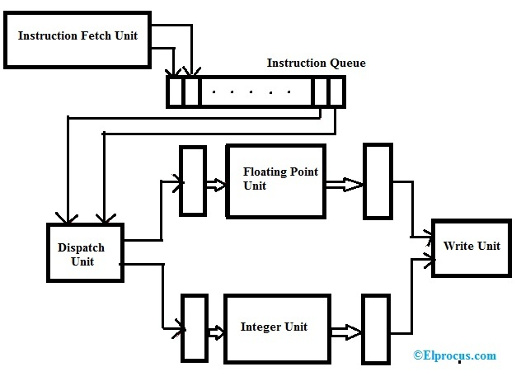
Lecture
SLIDE 5 / 10
Dynamic Instruction Scheduling
1
Dynamic scheduling allows the hardware to reorder instructions at runtime based on operand availability.
2
The Tomasulo algorithm uses reservation stations to manage instruction execution out of order.
3
Control logic tracks instruction status to ensure correct results are written to the register file.
4
This technique hides latency from memory accesses and reduces control unit bottlenecks.
5
Performance improves significantly when the control unit can issue independent instructions in parallel.
Superscalar Processor : Architecture, Features, Types & Its Uses (source: www.elprocus.com)
Chandigarh University
5 / 10
Notes:
Dynamic scheduling allows the hardware to reorder instructions at runtime based on operand availability rather than program order. The Tomasulo algorithm uses reservation stations to manage instruction execution out of order, which is crucial for superscalar performance. Control logic tracks instruction status to ensure correct results are written to the register file in the correct sequence. This technique hides latency from memory accesses and significantly reduces control unit bottlenecks.

Slide 6
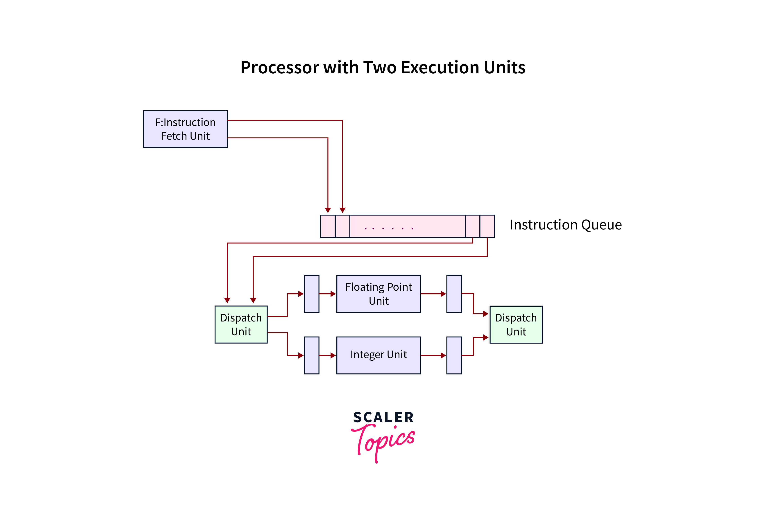
Lecture
SLIDE 6 / 10
Register Renaming and Control
1
Register renaming eliminates false dependencies by mapping architectural registers to physical registers dynamically.
2
The control unit maintains a mapping table to track the current physical register for each instruction.
3
This technique prevents Write-After-Read and Write-After-Write hazards without stalling the pipeline.
4
Physical registers are allocated from a free list managed by the control logic hardware.
5
Renaming increases the number of instructions that can be executed in parallel within a cycle.
Superscalar Architecture - Scaler Topics (source: www.scaler.com)
Chandigarh University
6 / 10
Notes:
Register renaming eliminates false dependencies by mapping architectural registers to physical registers dynamically during execution. The control unit maintains a mapping table to track the current physical register for each instruction in flight. This technique prevents Write-After-Read and Write-After-Write hazards without stalling the pipeline, allowing for higher throughput. Physical registers are allocated from a free list managed by the control logic hardware to ensure efficient resource usage.

Slide 7
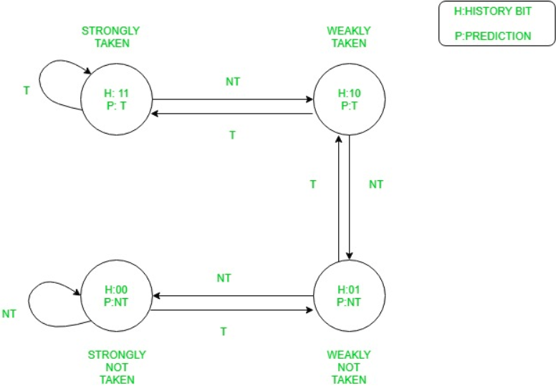
Lecture
SLIDE 7 / 10
Branch Prediction in Superscalars
1
Branch prediction guesses the outcome of conditional branches to keep the pipeline full.
2
Dynamic branch predictors use history tables to improve accuracy for superscalar processors.
3
Incorrect predictions cause pipeline flushes, reducing the effective instruction throughput significantly.
4
The control unit must quickly resolve branch outcomes to minimize performance penalties.
5
Speculative execution allows the processor to continue fetching instructions based on predictions.
Source: media.geeksforgeeks.org
Chandigarh University
7 / 10
Notes:
Branch prediction guesses the outcome of conditional branches to keep the pipeline full and avoid stalls. Dynamic branch predictors use history tables to improve accuracy for superscalar processors by learning from past behavior. Incorrect predictions cause pipeline flushes, which reduces the effective instruction throughput significantly and wastes cycles. The control unit must quickly resolve branch outcomes to minimize performance penalties during speculative execution.

Slide 8
Lecture
SLIDE 8 / 10
Structural Hazard Resolution
1
Structural hazards occur when multiple instructions require the same hardware resource simultaneously.
2
The control unit detects conflicts and stalls or reroutes instructions to available functional units.
3
Hardwired logic can resolve simple structural hazards faster than microprogrammed sequences.
4
Multiple functional units reduce the frequency of structural hazards in superscalar designs.
5
Control logic must prioritize instructions to maintain high instruction throughput and efficiency.
Chandigarh University
8 / 10
Notes:
Structural hazards occur when multiple instructions require the same hardware resource simultaneously, creating a bottleneck. The control unit detects these conflicts and stalls or reroutes instructions to available functional units to resolve them. Hardwired logic can resolve simple structural hazards faster than microprogrammed sequences, which is critical for speed. Multiple functional units reduce the frequency of structural hazards in superscalar designs, improving overall efficiency.

Slide 9

Lecture
SLIDE 9 / 10
Key Takeaways
1
Superscalar processors require advanced control units to manage parallel instruction execution effectively.
2
Dynamic scheduling and register renaming are essential for eliminating dependencies and maximizing throughput.
3
Accurate branch prediction is critical to prevent pipeline flushes and maintain high performance.
4
Hardwired control is generally preferred for speed in high-frequency superscalar architectures.
5
Evaluating control unit design involves balancing complexity, latency, and parallel execution capabilities.
Source: www.slideteam.net
Chandigarh University
9 / 10
Notes:
To summarize, superscalar processors require advanced control units to manage parallel instruction execution effectively and efficiently. Dynamic scheduling and register renaming are essential techniques for eliminating dependencies and maximizing throughput in modern processors. Accurate branch prediction is critical to prevent pipeline flushes and maintain high performance during program execution. Finally, evaluating control unit design involves balancing complexity, latency, and parallel execution capabilities for optimal results.

Slide 10
Lecture
SLIDE 10 / 10
References
COMPUTER ORGANIZATION AND DESIGN
The Hardware/Software Interface — David A. Patterson, John L. Hennessy
COMPUTER ARCHITECTURE
A Quantitative Approach — John L. Hennessy, David A. Patterson
• Computer Organization and Architecture — William Stallings
• Computer System Architecture — M. Morris Mano & Rajib Mall
• Computer Organization — Carl Hamacher, Zvonko Vranesic, Safwat Zaky
Chandigarh University
10 / 10
Notes:
These five textbooks provide the foundational knowledge for understanding computer organization and architecture. William Stallings and M. Morris Mano offer excellent insights into control unit design and pipelining. Carl Hamacher and the works by Patterson and Hennessy provide quantitative approaches to performance evaluation. Please refer to these resources for deeper study on superscalar architectures and control strategies.

